Slide 1

Reducing Air Traffic Delays in Los Angeles
Jerry Chen
Jules Pommies
John Stuart
Brian Tam
Jonathan Wegleitner
University of California, Berkeley
December 2016
Notes:
Everyone. Jerry to say title

Slide 2
Intro: Los Angeles
The Los Angeles Area is one of the busiest air traffic regions in the world
Population: 18 million (2nd largest in US)
Commercial air service from 5 airports: LAX, SNA, LGB, ONT, BUR
Of these, LAX by far serves the most destinations and has the greatest frequency of commercial flights
The 4 other airports almost exclusively serve domestic destinations
LAX is often preferred due to high frequency of flights and more non-stop destinations
However, LAX has many problems including delays and efficiency
Notes:
Jerry

Slide 3
Intro: LAX
From 2010 to 2016, LAX ranked as #1 for the longest delay in taxi-in time
Closely spaced terminals allow only one aircraft on the apron taxiway at a time
Closely spaced taxiways can restrict ground aircraft movement
Taxiway weight restrictions result in longer taxi times
Almost constant construction results in runway and taxiway closures
Horseshoe terminal layout makes inter-terminal transitions difficult
Los Angeles road traffic makes LAX difficult to get to
LAX is bounded in all 4 directions and almost impossible to expand
Notes:
Jerry

Slide 4
Intro: LA Area Airports
The 4 other LA Area airports are far away from operating near capacity
Airline service already exists at these airports:
SNA serves over 20 destinations through 7 carriers
LGB serves about 15 destinations through 4 carriers
ONT serves about 15 destinations through 7 carriers
BUR serves about 13 destinations through 6 carriers
These airports are located around the Los Angeles Area
Notes:
Jery

Slide 5
Intro: LA Area Airports
However, these airports carry curfews and restrictions
SNA has night curfews with operations prohibited between 11PM and 7AM
Especially noisy aircraft are also prohibited from flying to the airport
LGB has noise and flight restrictions, but no curfew
BUR has noise restrictions and curfew on especially noisy aircraft
ONT has no explicit noise restrictions or curfew in place
These airports’ runways may not accommodate very large aircraft
Notes:
Jerry

Slide 6
Motivation
Aircraft delays are costly, inefficient, and unpleasant
Airlines must pay more for crew time, fuel, and other resources
Additional airline costs if delay causes missed connections
Interferes with airport departure slots and can cause ripple effect
Generates unnecessary noise and fuel pollution
Creates stress for travelers
Air traffic delays affect everybody, especially at a scale such as LAX
Travelers
Ground Transportation
Pilots, Flight Attendants, Airline and Airport Ground Service Agents
Air Traffic Controllers
Notes:
Jerry

Slide 7
Research Question
How can these delays be reduced?
Proposed Solution: Redistribute air traffic among LA Area airports
Forced market - flights no longer offered based on demand
Scheduled flights are assigned based on how congested LAX is at a particular time of day
Sole criteria for redistribution: reducing the ground delay at LAX
Additional Considerations
Reduced delay will reduce environmental, operational costs
Travelers must receive incentives for loss of convenience
Notes:
Jerry

Slide 8
Broad Theory
LAX is not always congested to extreme degrees
Most notable delays in later morning and later afternoon rushes
Travelers are generally flexible
Passengers are already willing to pay more for airfare from other airports because of better travel experience
Relatively few travelers live exclusively close to a certain airport
Demand is steady and increasing to other airports
Costs of loss of free market do not outweigh benefits of better efficiency
Notes:
Jerry

Slide 9
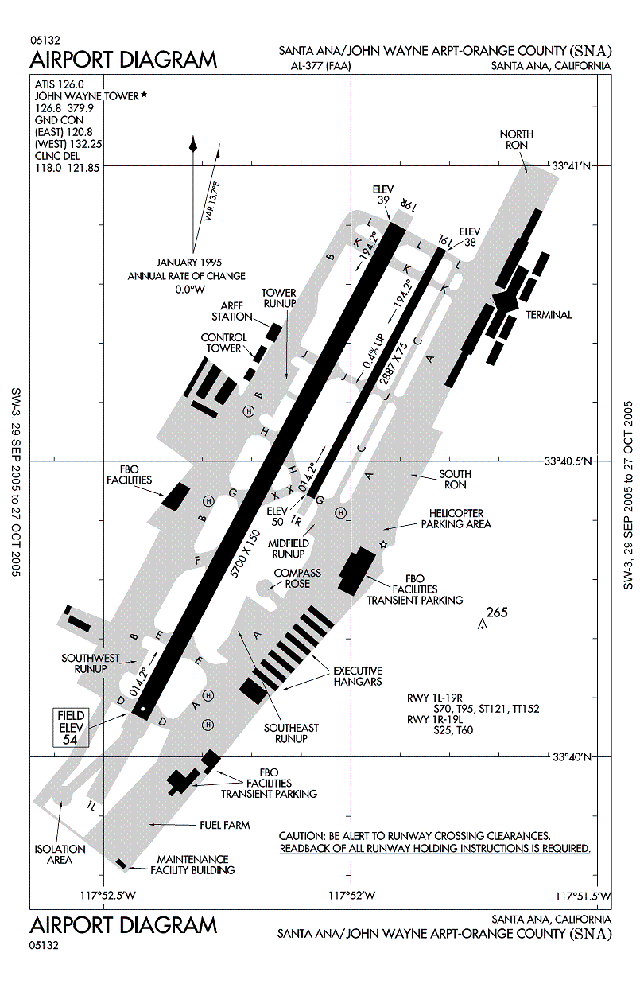
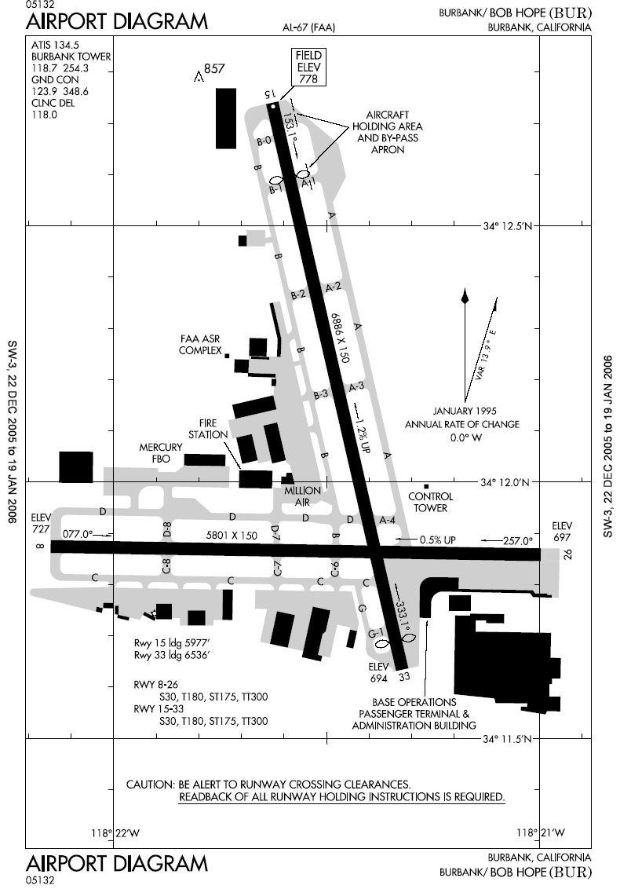
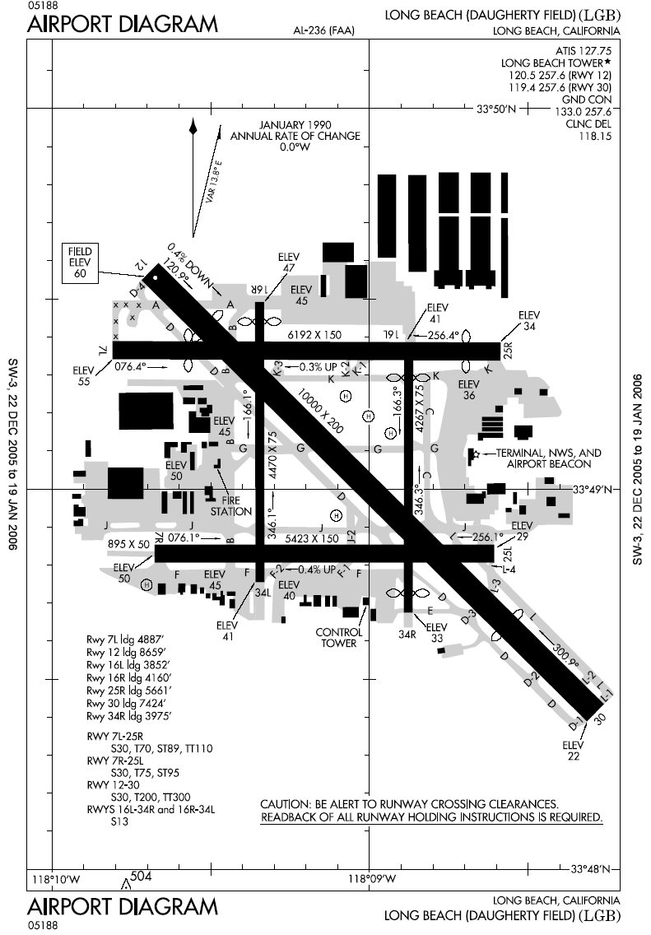
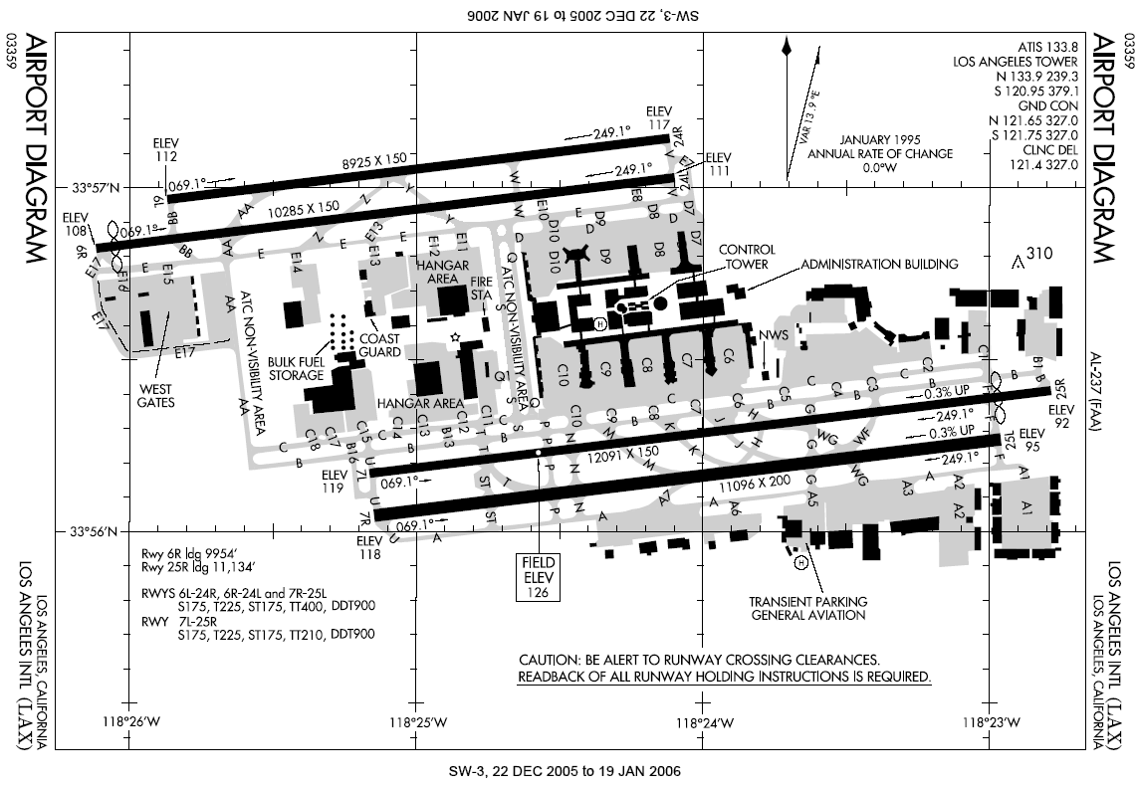
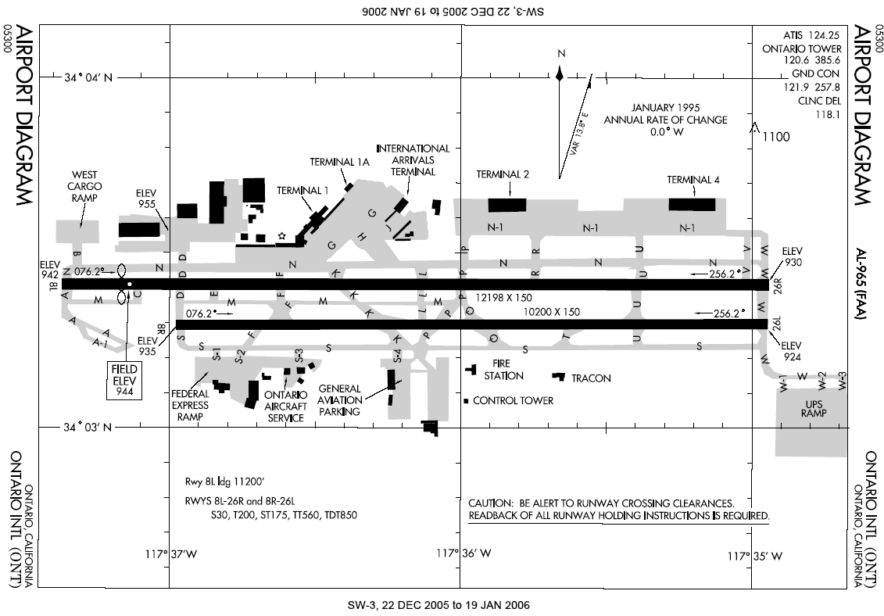
Background: Five Major Airports
LAX
John Wayne
Ontario
Bob Hope
Long Beach
Notes:
Brian

Slide 10
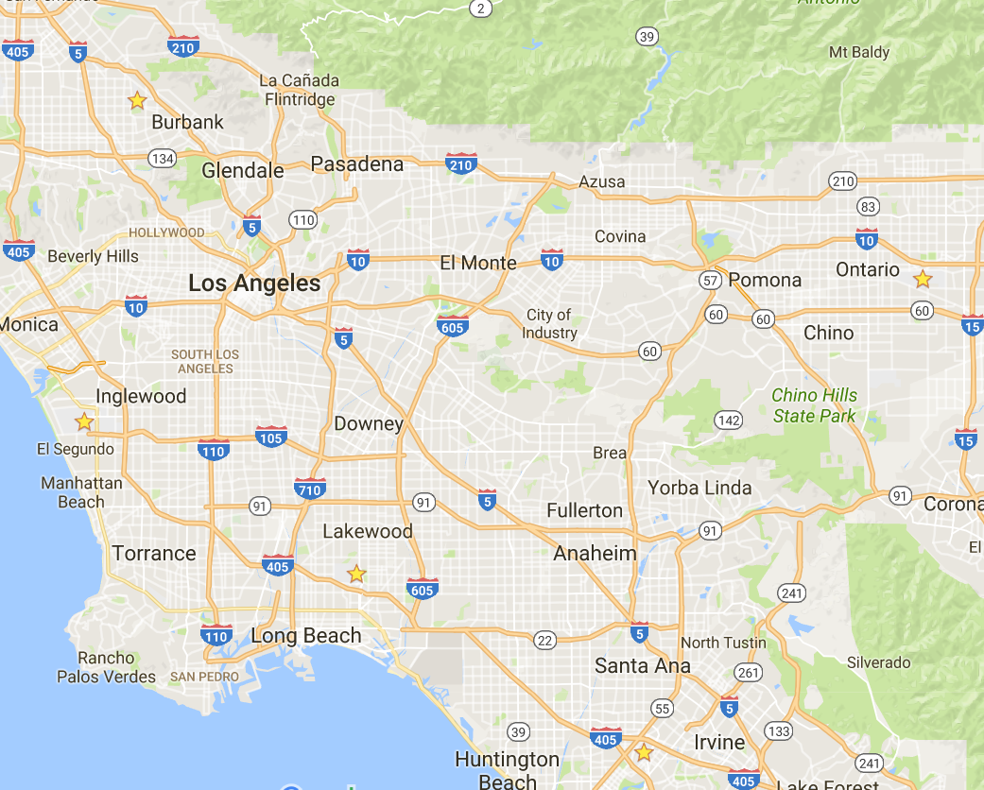
Location:
Five Major
Airports
Notes:
Brian

Slide 11
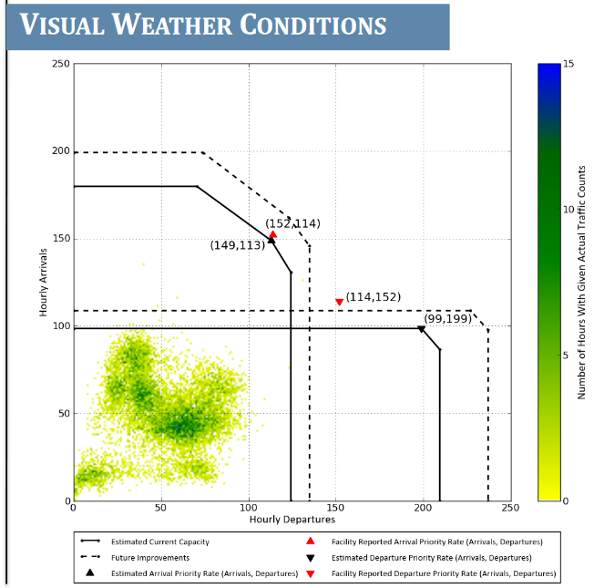
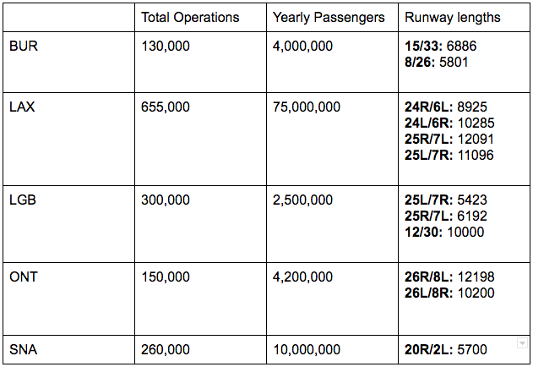
Opportunity to Improve
DEN
Notes:
Jack - Background stats
Brian - Capacity visualization

Slide 12
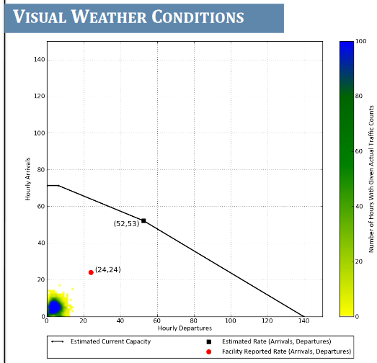
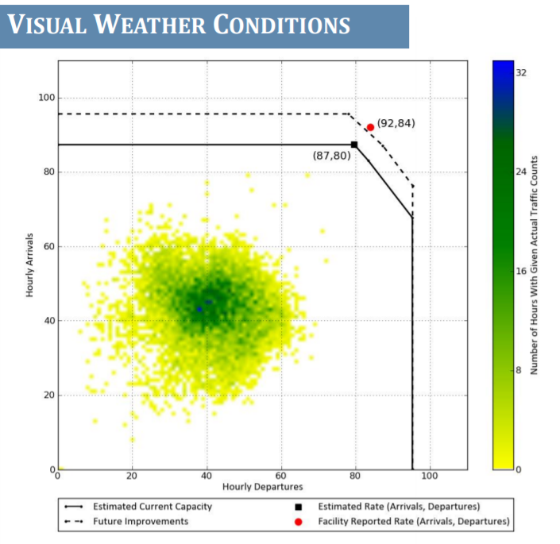
LGB
LAX
Notes:
Brian

Slide 13
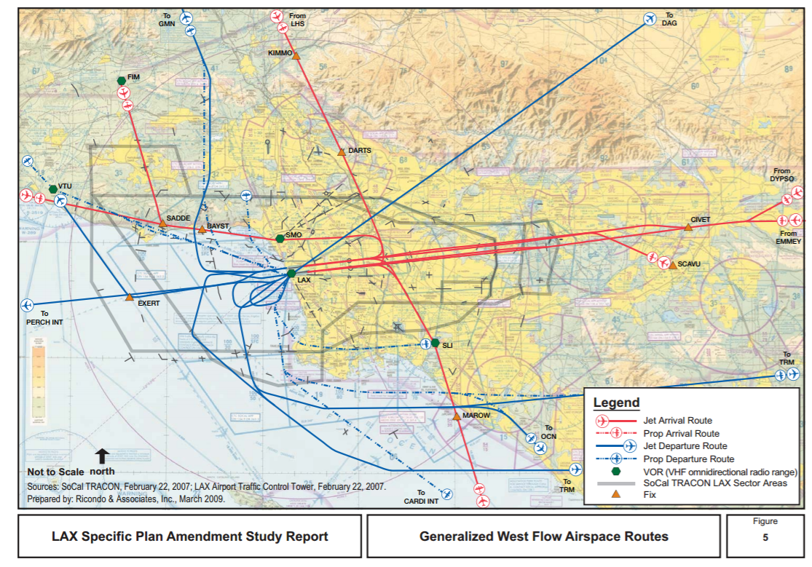
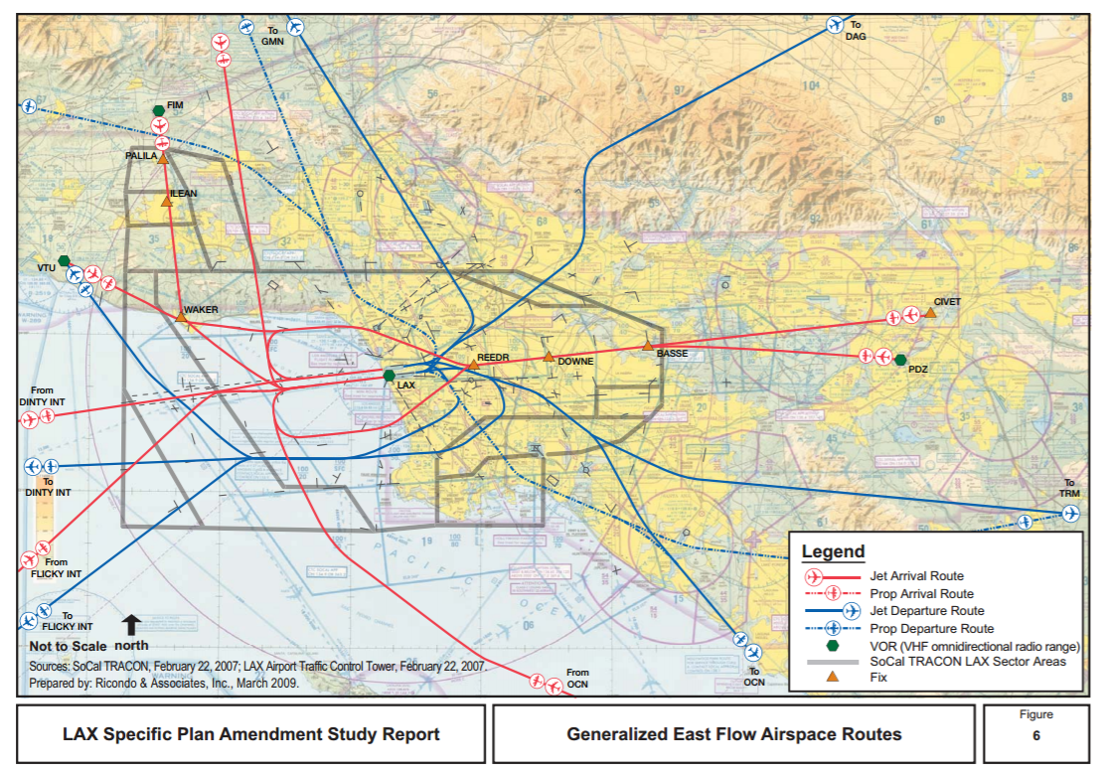
LAX Approach and departure paths
Notes:
Jack

Slide 14
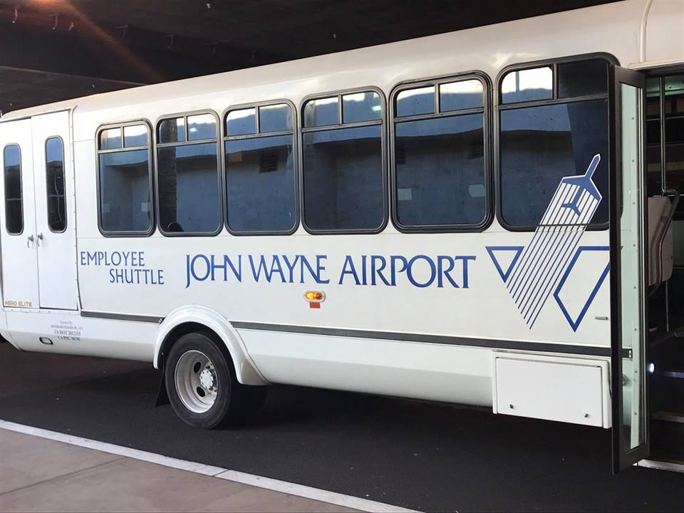
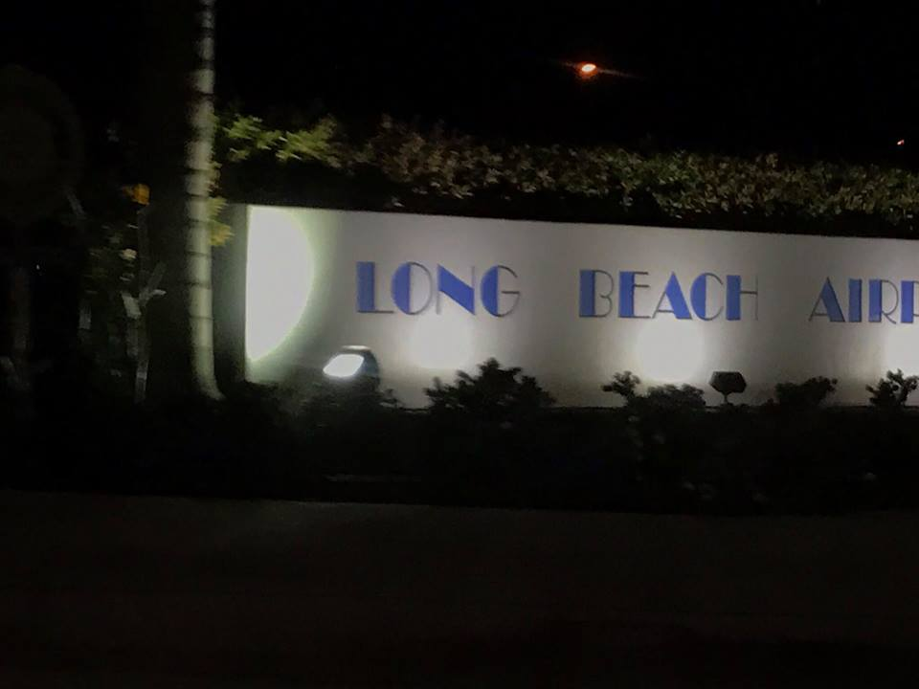
John Wayne / Long Beach Trip
Notes:
Brian

Slide 15
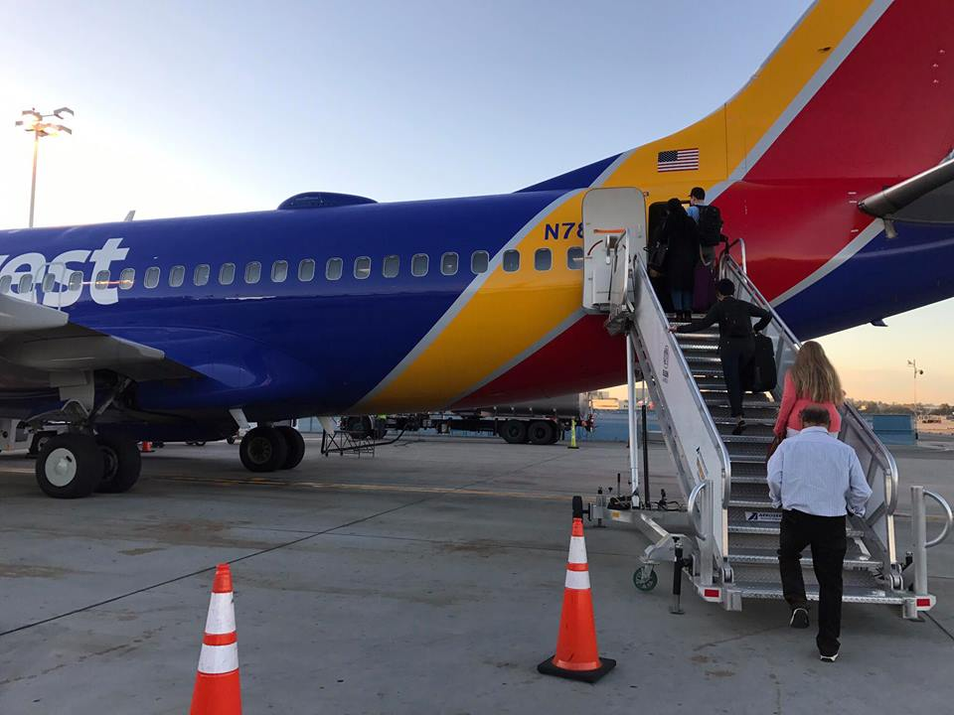
Notes:
Brian

Slide 16

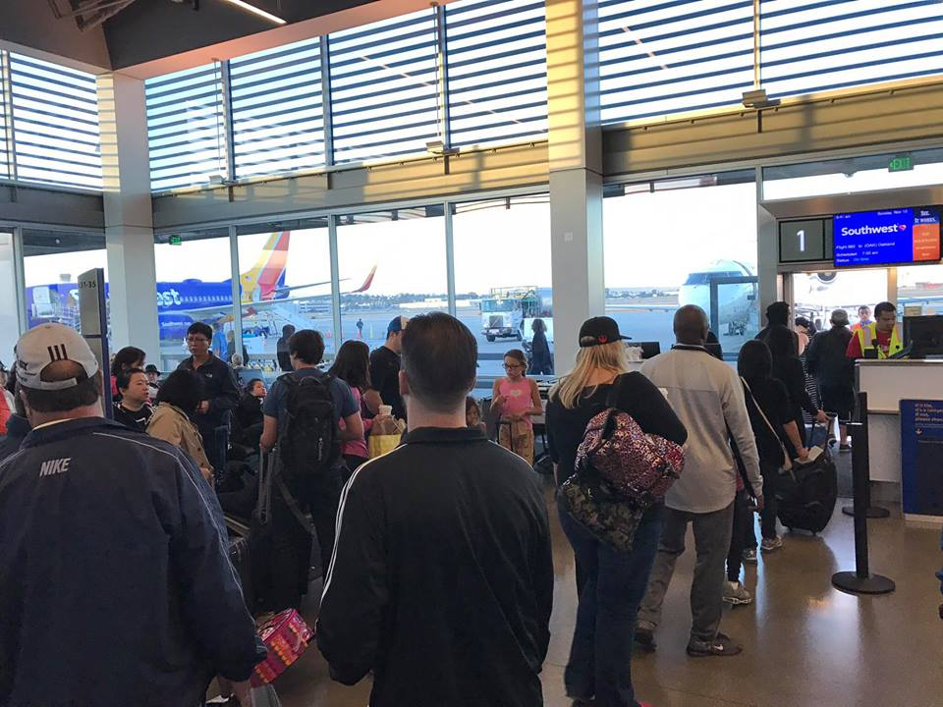
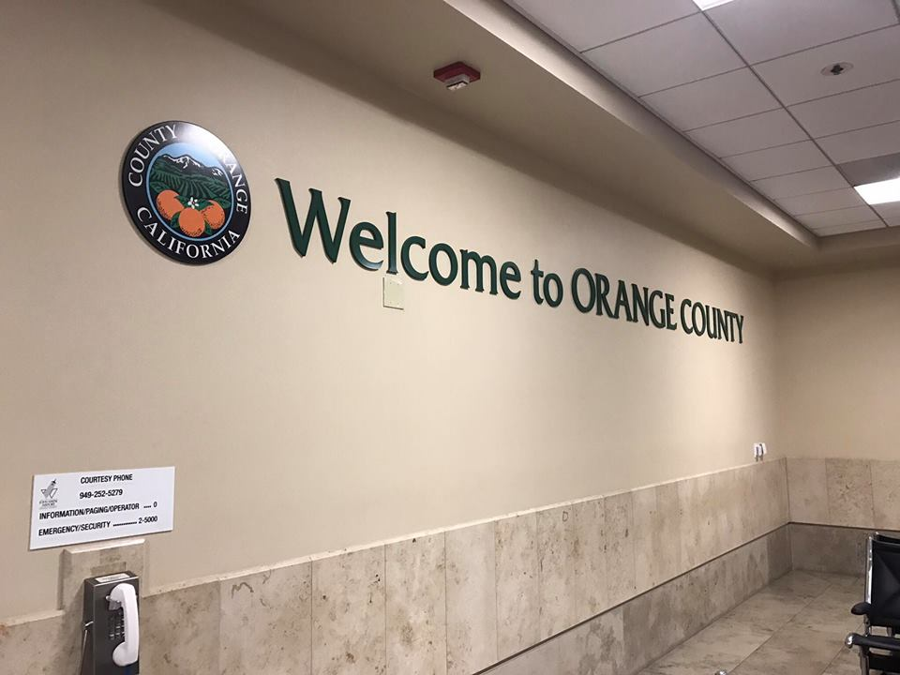
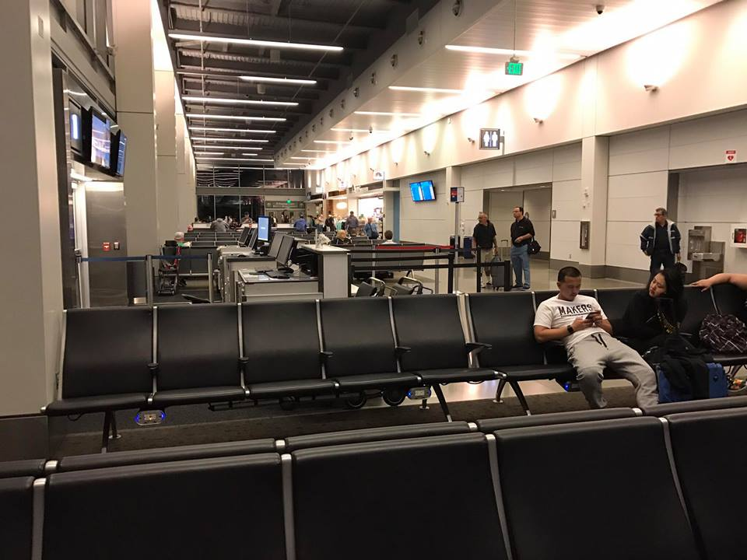
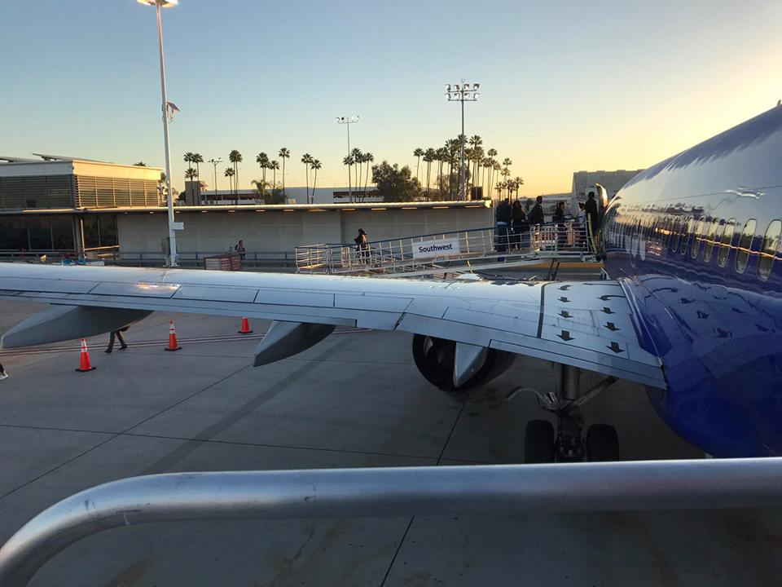
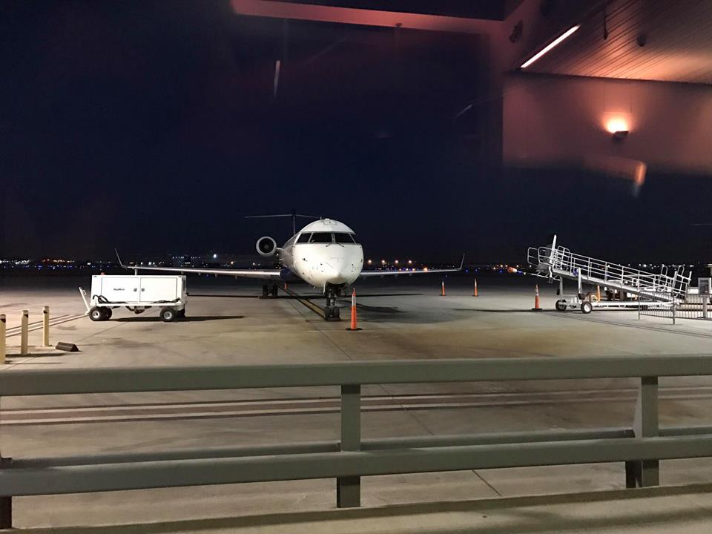
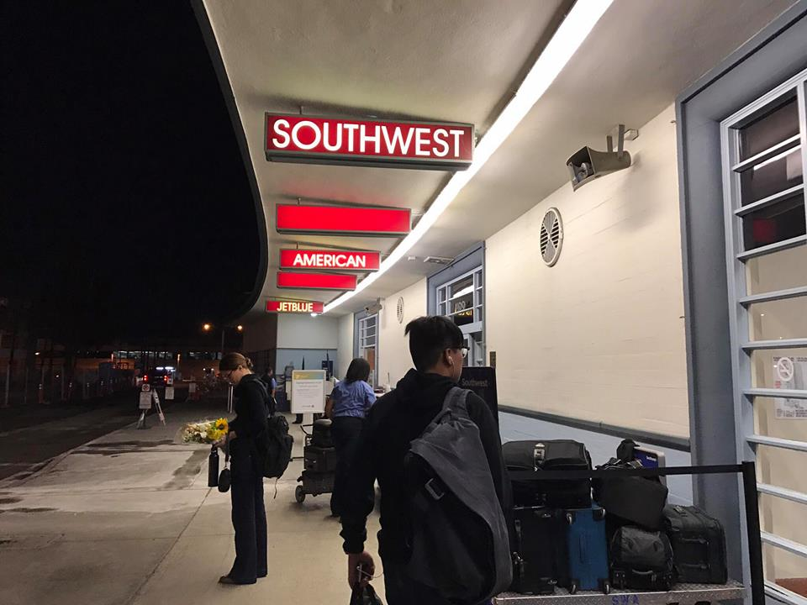
Notes:
Brian

Slide 17
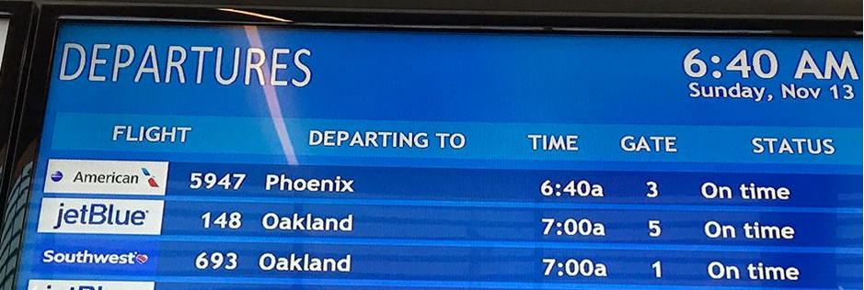
Forced market: Can we make this more optimal?
Notes:
Brian

Slide 18
Methodology
Research Question
Background Research
Obtain Data
Data Visualization
Landside Analysis
Program Development
Suggested Implementation
MILP
Implementation
Dynamic Program
Notes:
Jack

Slide 19
Existing Air Service System
Airports offer slots to airlines, which set a maximum on airline service
May be bounded by number of flights, or number of passengers
Are distributed to airlines according to legal procedures
Slots can be as restrictive as they need to be
Airlines schedule flights in accordance with their slot allocations
Generally, slots dictate how many gates are available
Airlines try to schedule flights to meet service demand
Airports are competitors, and generally operate independent of another
Exceptions for when departure paths cross, or other factors
Notes:
Jack

Slide 20
Data Categories
Carrier
Airport
Flight Plan Gate Out
Actual Gate Out
Flight Plan Gate In
Actual Gate In
Unimpeded Taxi Out Time
Taxi Out Time
Taxi Out Time Difference
Taxi Out Delay
Estimated Time Enroute
Tail Number
ACID
Actual Airborne Time
Airborne Time Difference
Airborne Delay
Unimpeded Taxi In Time
Taxi In Time
Taxi In Time Difference
Taxi In Delay
Scheduled Block Time
Actual Block Time
Block Time Difference
Block Delay
Departure
Arrival
Notes:
Jack
Aviation System Performance Metrics (ASPM)

Slide 21
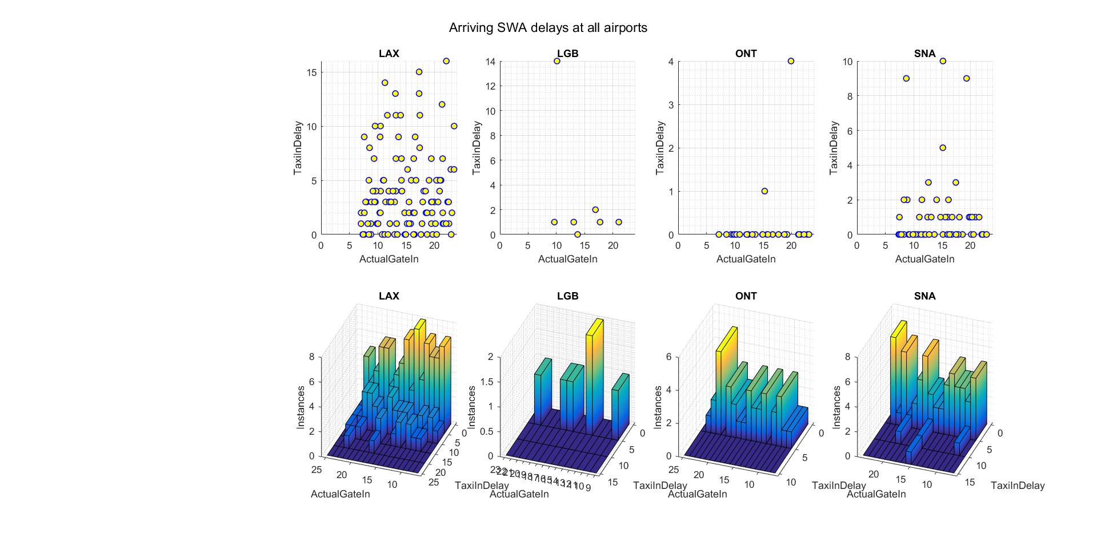
Initial Data Interpretation
Southwest Airlines
Notes:
Jack

Slide 22
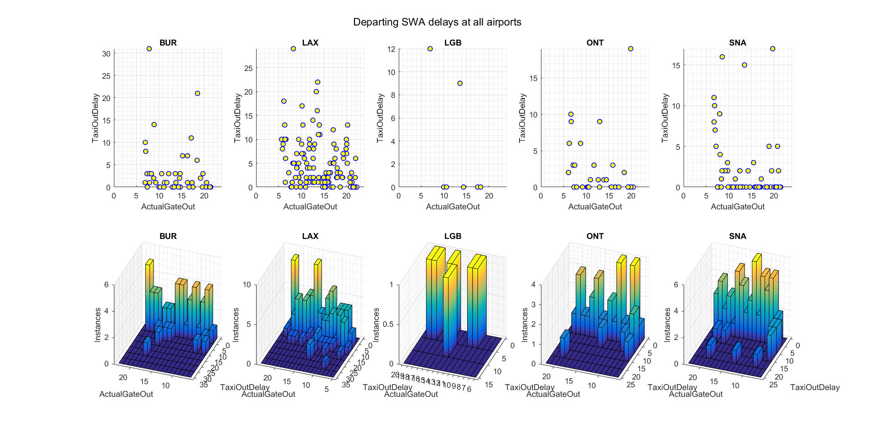
Initial Data Interpretation
Southwest Airlines
Notes:
Jack

Slide 23
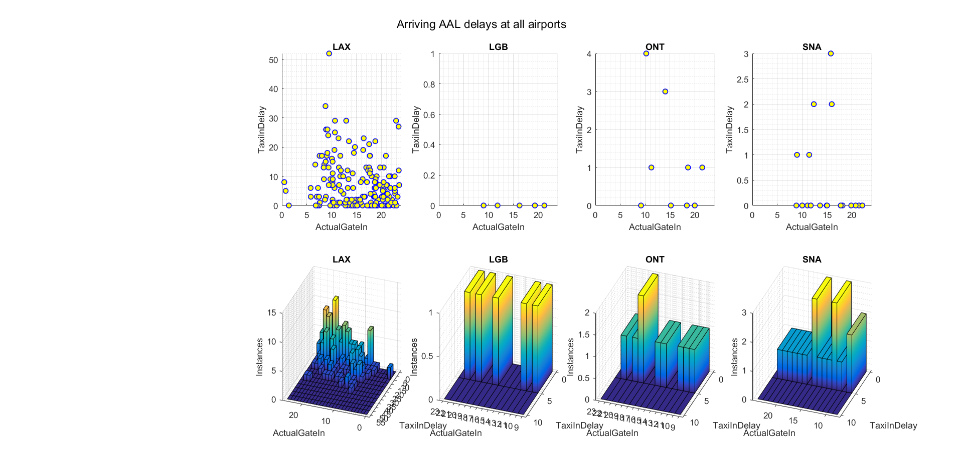
Initial Data Interpretation
American Airlines
Notes:
Jack

Slide 24
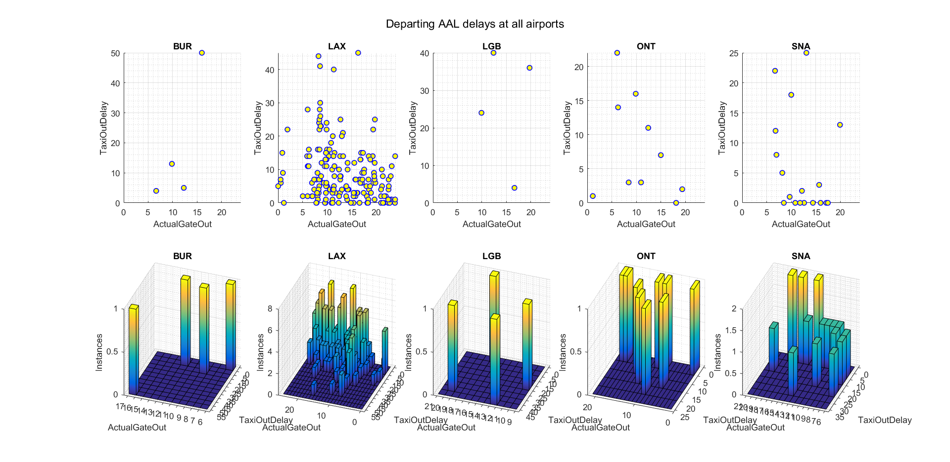
Initial Data Interpretation
American Airlines
Notes:
Jack

Slide 25
Modeling - Two Approaches
Mixed Integer Linear Programming
Uses linear programming and branch and bound algorithm to optimize
Easy to implement and change
Very time inefficient for large numbers of aircraft
Time complexity unpredictable for difficult scenarios
Dynamic Programming
Uses recursion to map optimal solutions
Complicated to implement
Theoretically less computationally intensive as MILP, with more predictable time complexity
Difficult to change constraints
Notes:
John

Slide 26
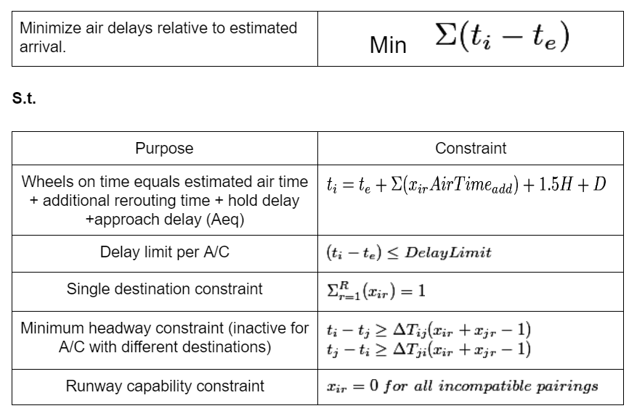
Approach 1 - MILP
Minimizes the sum of difference between an aircraft’s earliest possible arrival time and new scheduled time
Imposes limit on delay of any one aircraft
Imposes FAA separation requirements on aircraft approaching the same runway.
Notes:
Jon

Slide 27
Assumptions
The MILP makes a number of permissible assumptions about aircraft dynamics and regulations to enable faster computation.
Schedules repeat over the course of days or weeks.
7 Runways for arrivals (2 each at LAX and LGB).
Aircraft arrive from 4 general directions, meaning additional flight time to each airport varies.
Once at an airport, all aircraft merge into a single approach path
Temporarily Relaxed Details:
Runway capabilities (based on weight class)
Variable headway requirements (an average of 90 seconds used)
Actual vs random origin direction
Notes:
John

Slide 28
Constraint Selection
Additional function (LongTermPlot.m) developed to explore the effect of constraints on delay
Looping over different scheduling window limits and available airport constraints, we can determine feasible constraints graphically.
Generated plots show the delay reduction effect of scheduling over a larger sample of airports.
LongTermPlot also graphs cumulative rerouting decisions from each sample set
Notes:
John

Slide 29
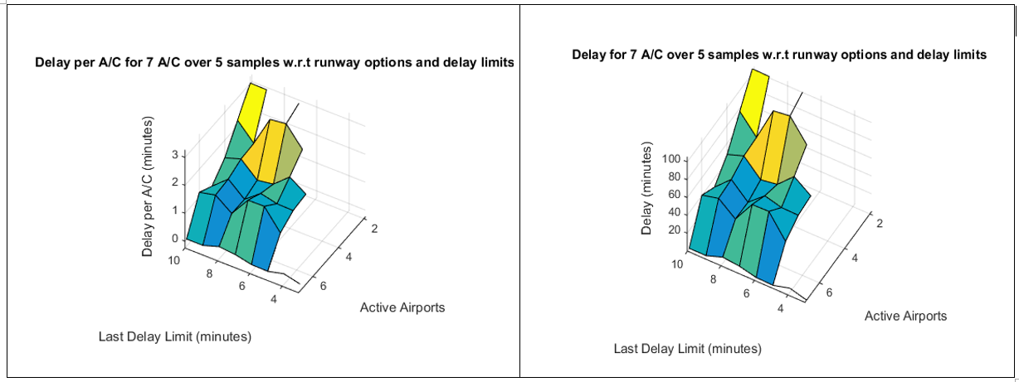
Output of Bivariate Constraint Program - (LongTermPlot.m)
Notes:
John

Slide 30
Implementation
Individual flight data is extracted from ASPM database
Aircraft equipment ID and other databases are used to determine: ➤ weight category ➤ fuel consumption ➤ point of origin ➤ original destination, ➤ separation requirements ➤ time impacts of changing destination
For loops assemble the constraint arrays A, B, Aeq, and beq from the data calculated in Step 2
Intlinprog function uses the simplex algorithm and branch and bound to explore options and find a delay minimizing schedule
Notes:
John

Slide 31
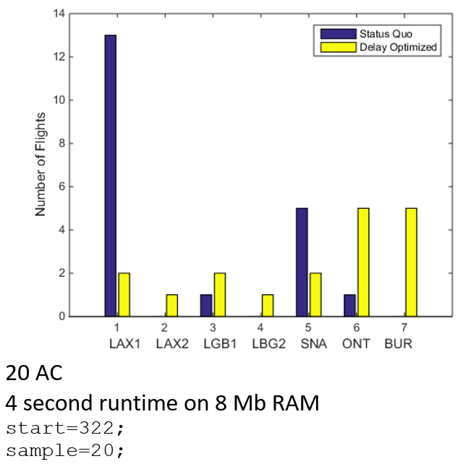
Results
Every iteration generates a plot of runway decisions and a complete schedule vector.
Originally sample sizes were too small to produce meaningful results. Most results would be either infeasible or have zero delay
Proper selection of a scheduling window solves this problem
Notes:
John - Proper scheduling windows also generate

Slide 32
Approach 2 - Dynamic
Dynamic programming takes a desired final state and systematically explores all possible ways of minimizing cost of reaching that state.
Previous work has been done on using dynamic programming to maximize minimum separation in air traffic (Bayen et al 2004) but minimizing delay takes a new approach.
This dynamic program seeks to pack “aircraft blocks” or windows of landing time and headway, into as small a timespan as possible.
Notes:
John

Slide 33
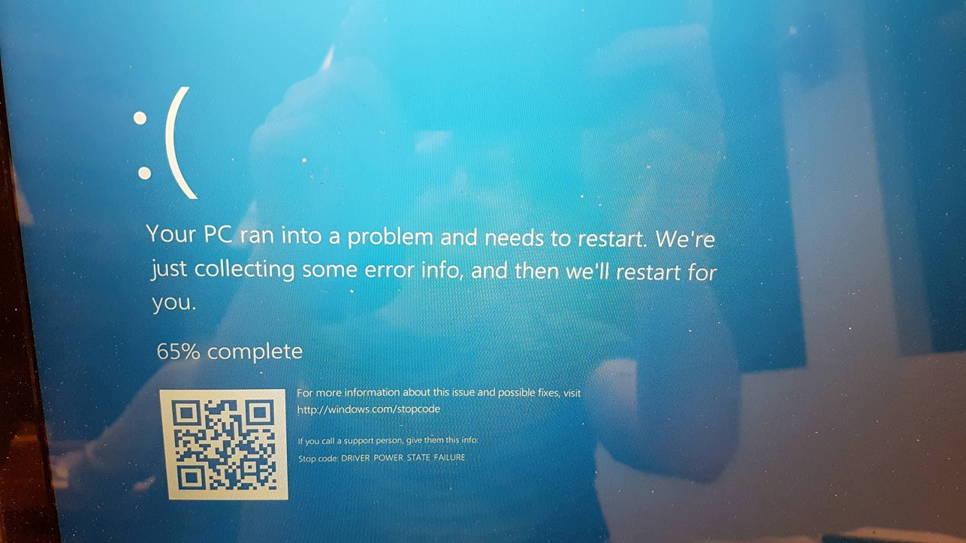
Issues and Improvements
MILP
Time efficiency has been improved with random points of origin and reducing the aircraft sample size
Number of variables increases polynomially, unknown O(f(N))
LongTermPlot.m function has provided optimal constraint combinations to try
Attempt iteration over entire day with
Dynamic
Additional debugging required
Notes:
John

Slide 34
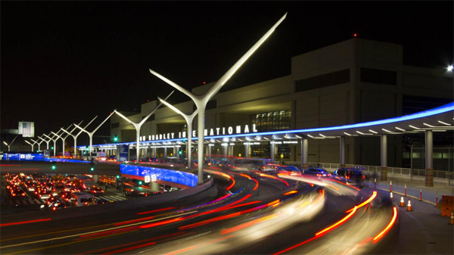
LAND-SIDE
Notes:
Jules

Slide 35
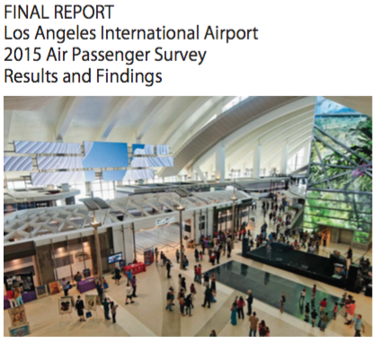
LAX Survey
Notes:
Jules

Slide 36
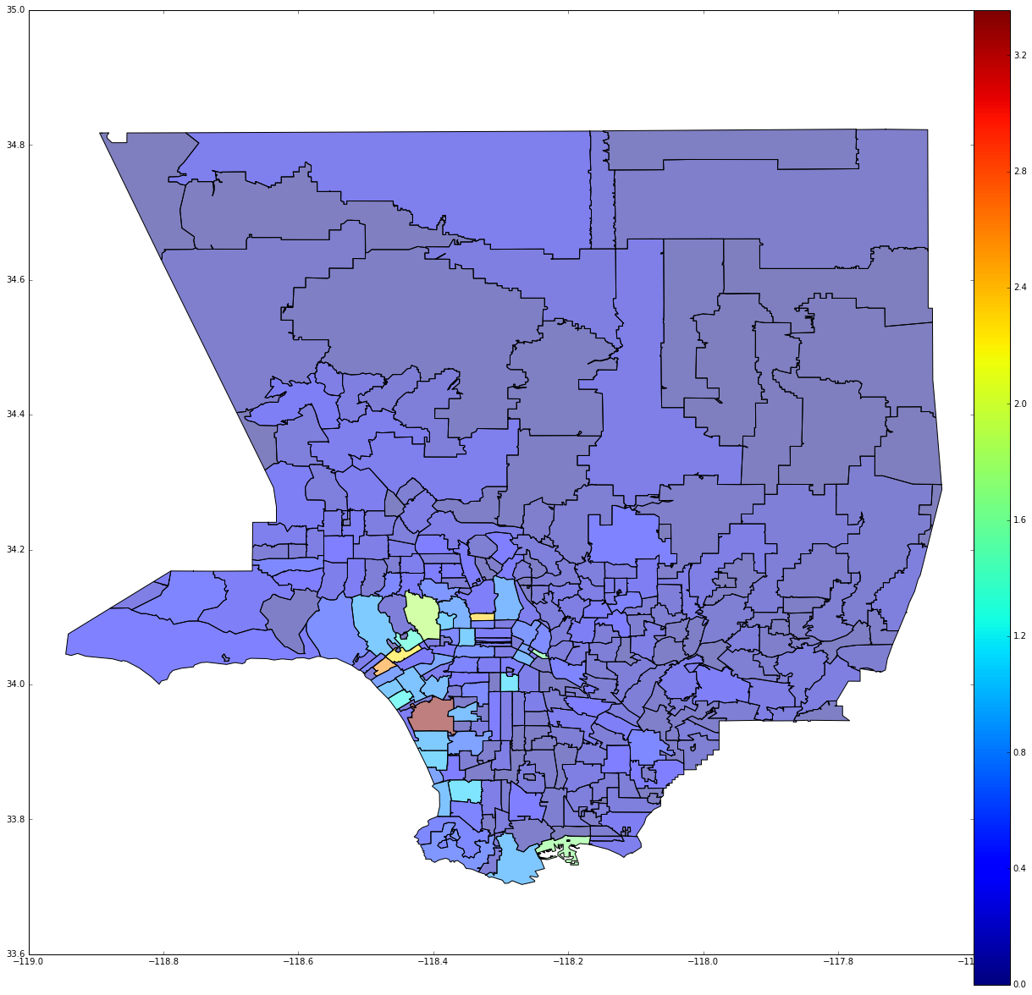
3,2%
2,8%
2,4%
Passenger
Origin
2,0%
1,6%
1,2%
0,8%
0,4%
Notes:
Jules

Slide 37
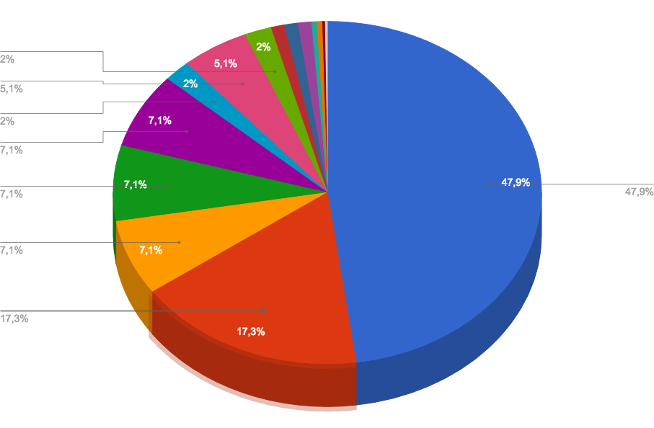
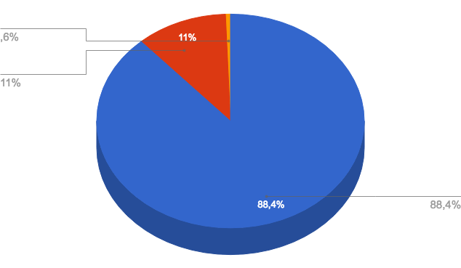
Ground Access Mode
Notes:
Jules

Slide 38

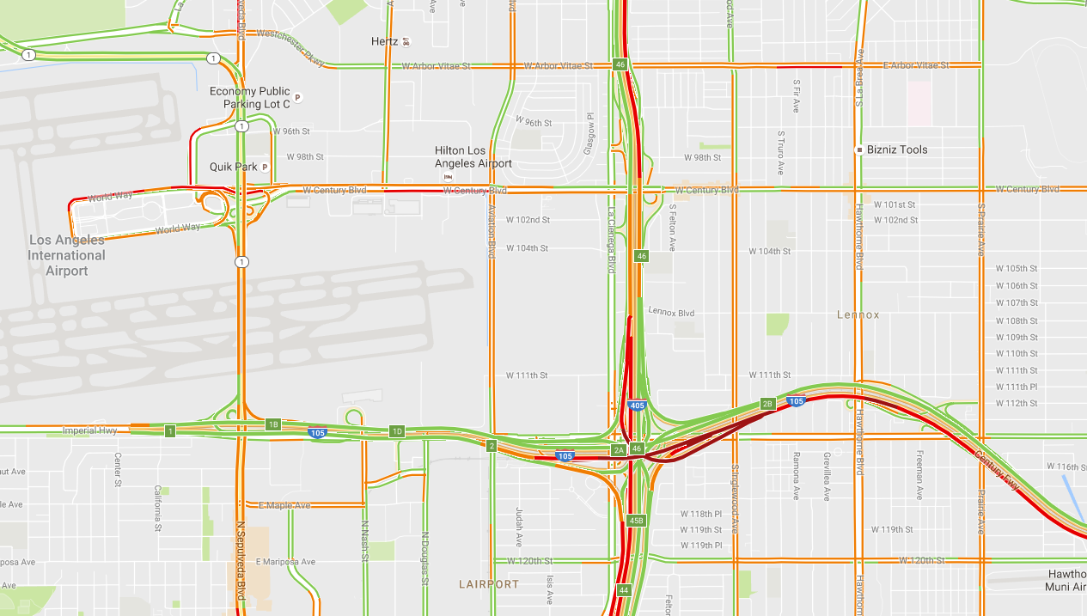
LAX
Notes:
Jules

Slide 39
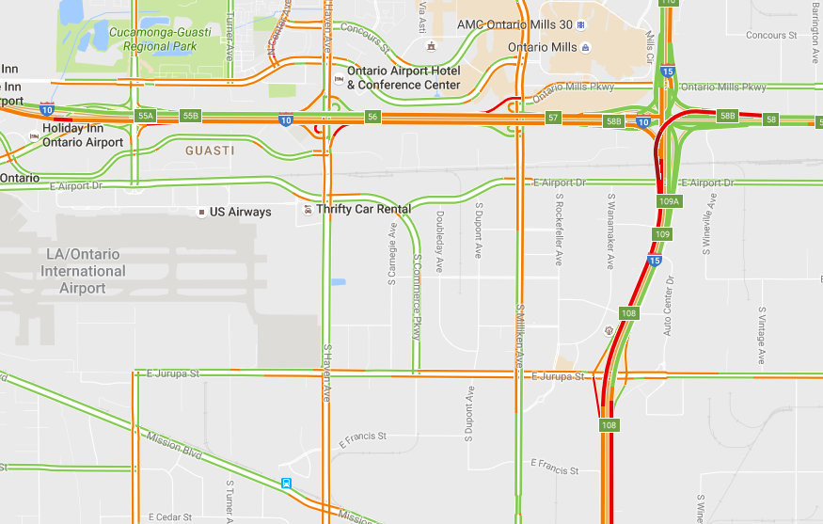
ONT
Notes:
Jules

Slide 40
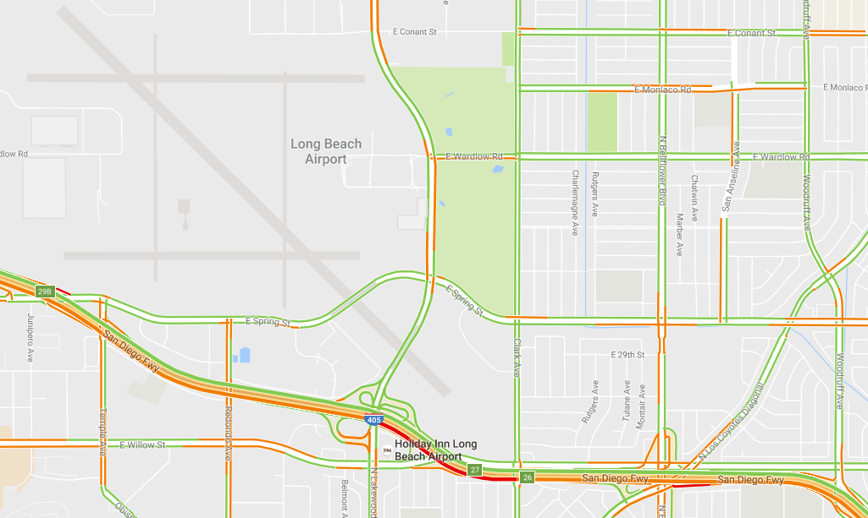
LGB
Notes:
Jules

Slide 41
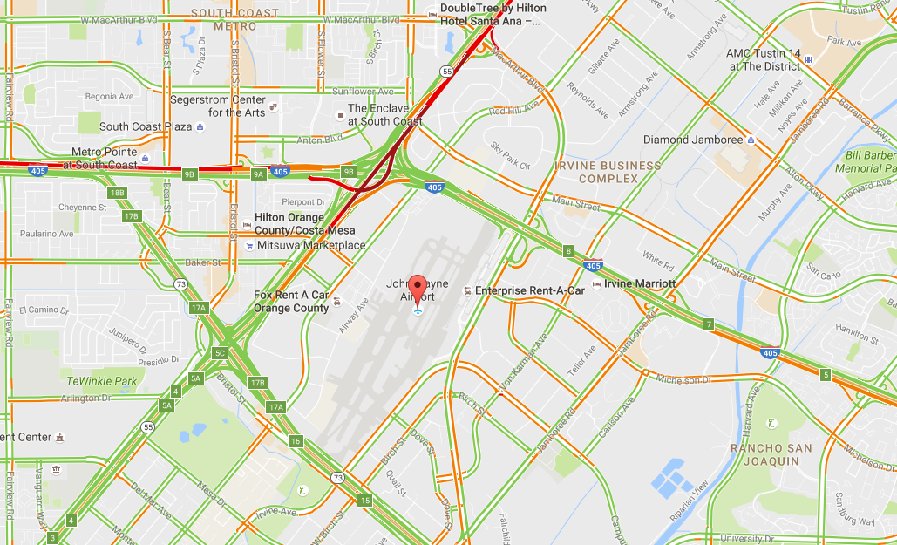
SNA
Notes:
Jules

Slide 42
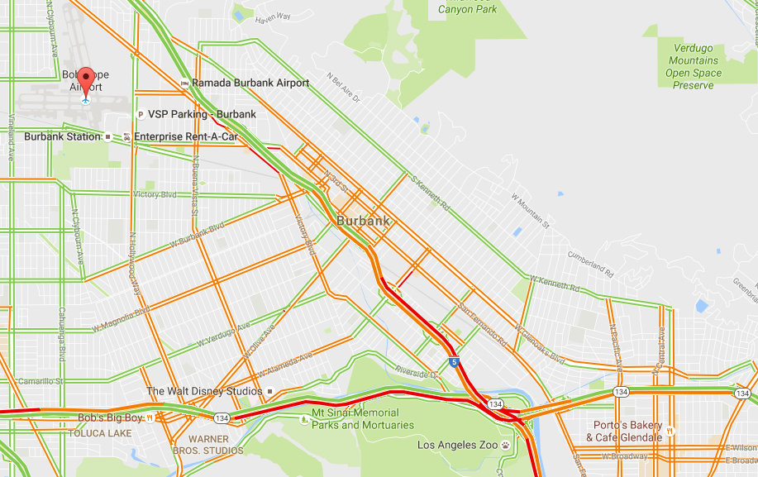
BUR
Notes:
Jules

Slide 43
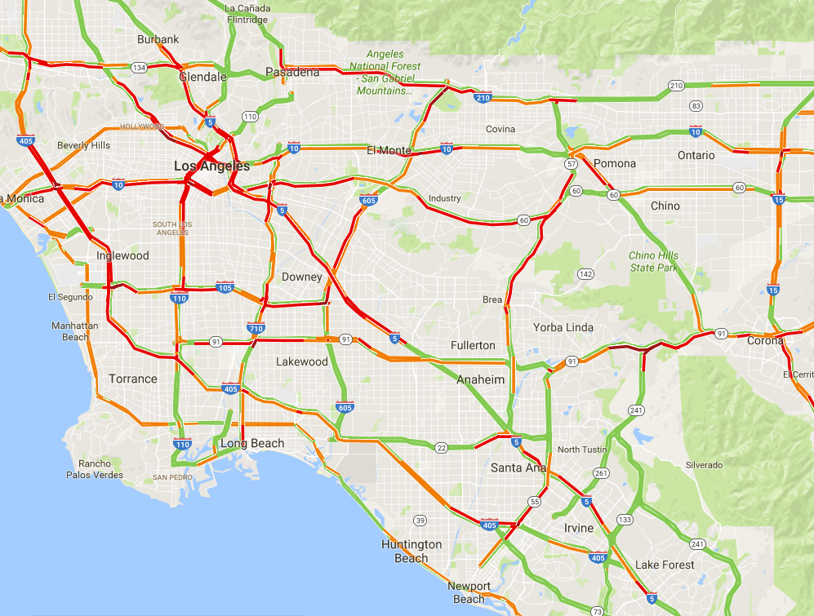
Los Angeles Traffic
Notes:
Jules

Slide 44
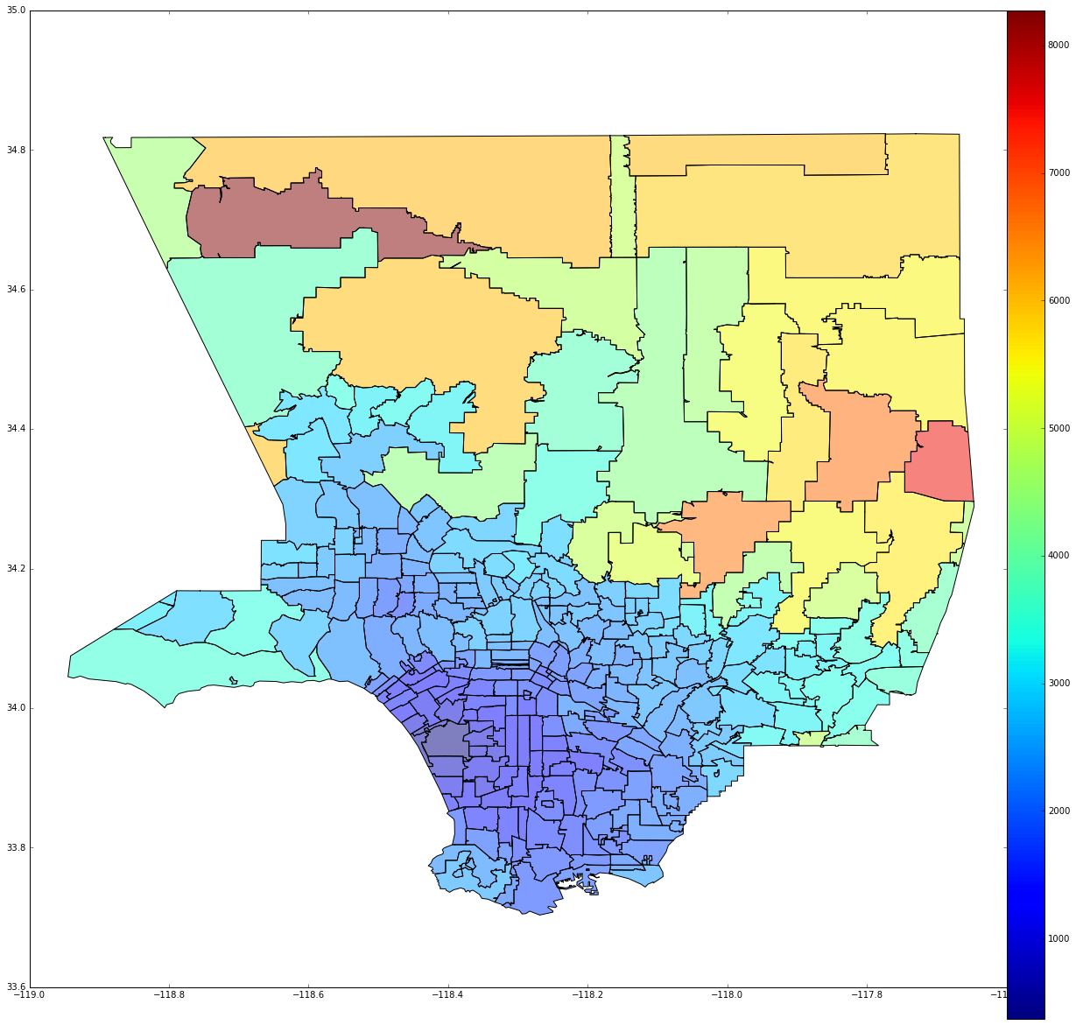
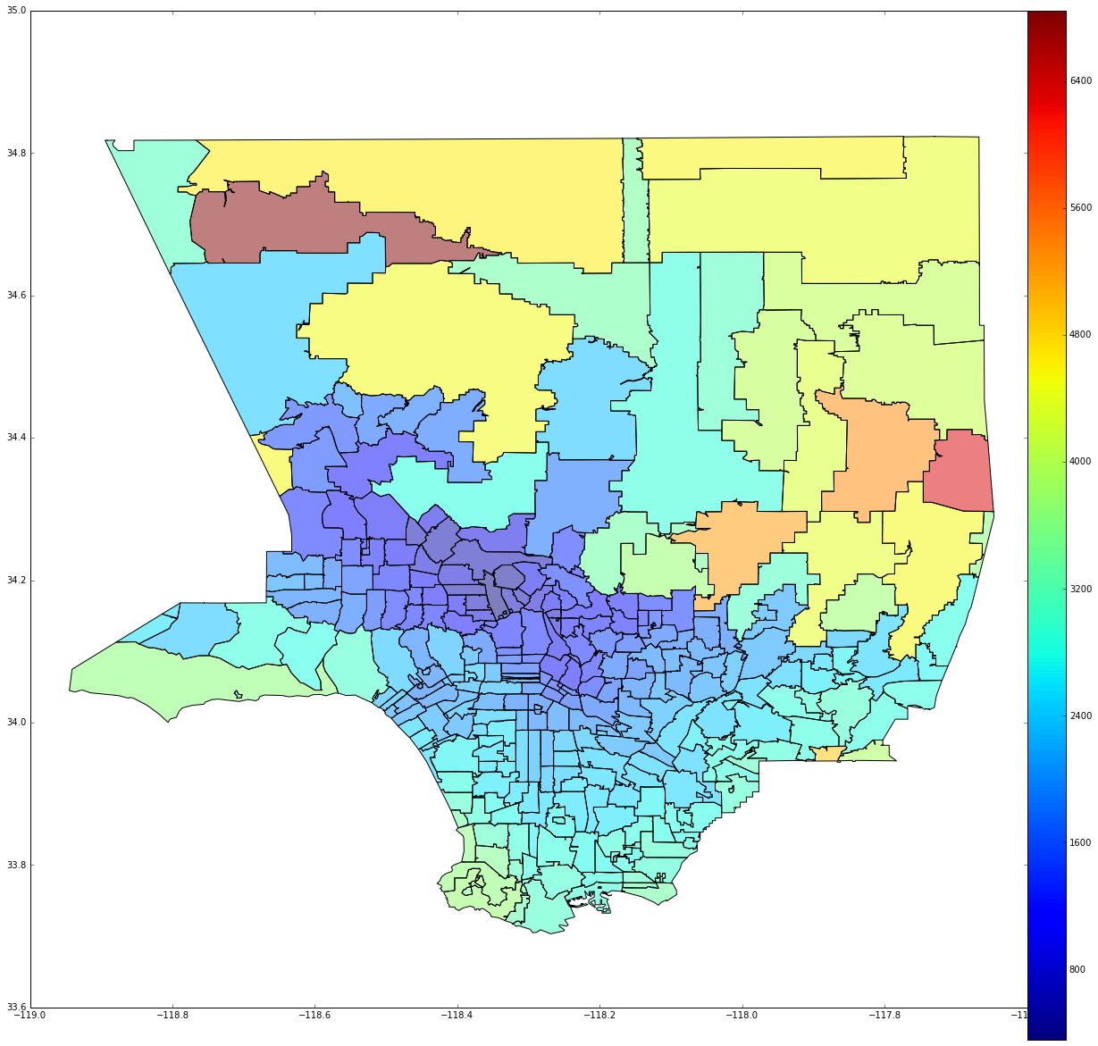
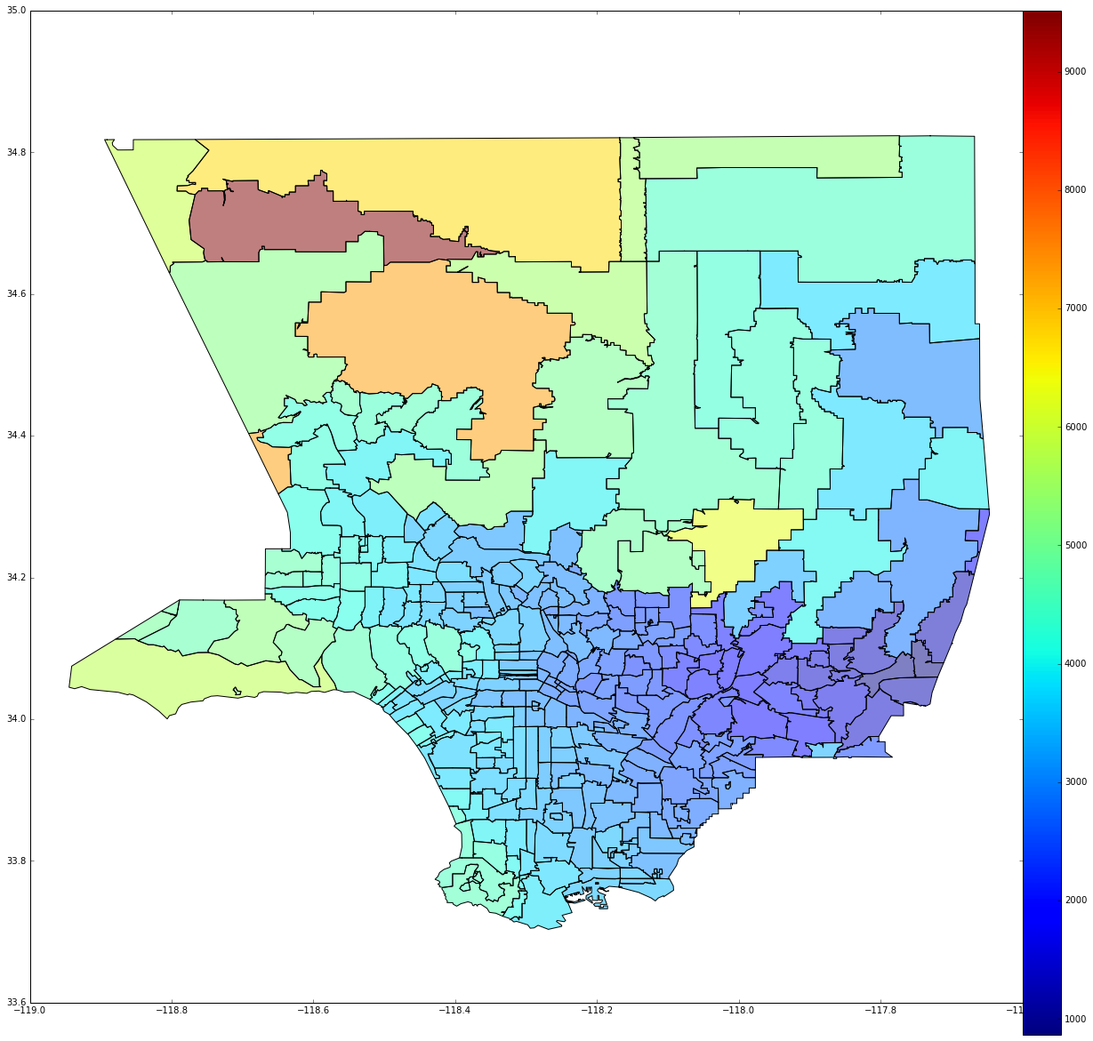
Travel Time
LAX
BUR
ONT
Notes:
Jules

Slide 45
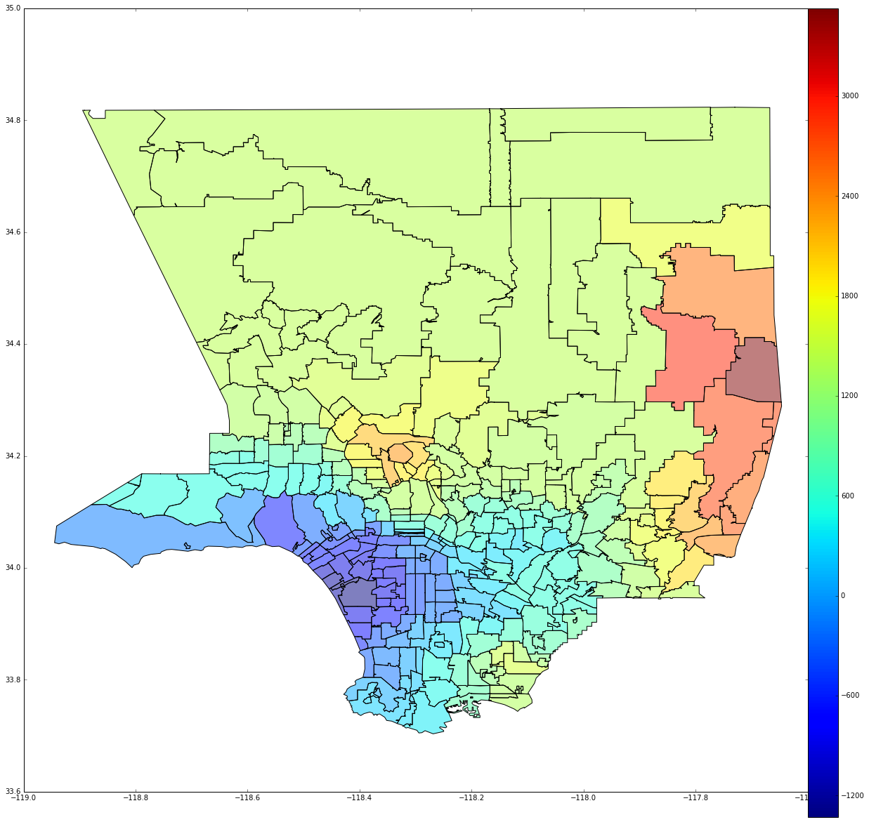
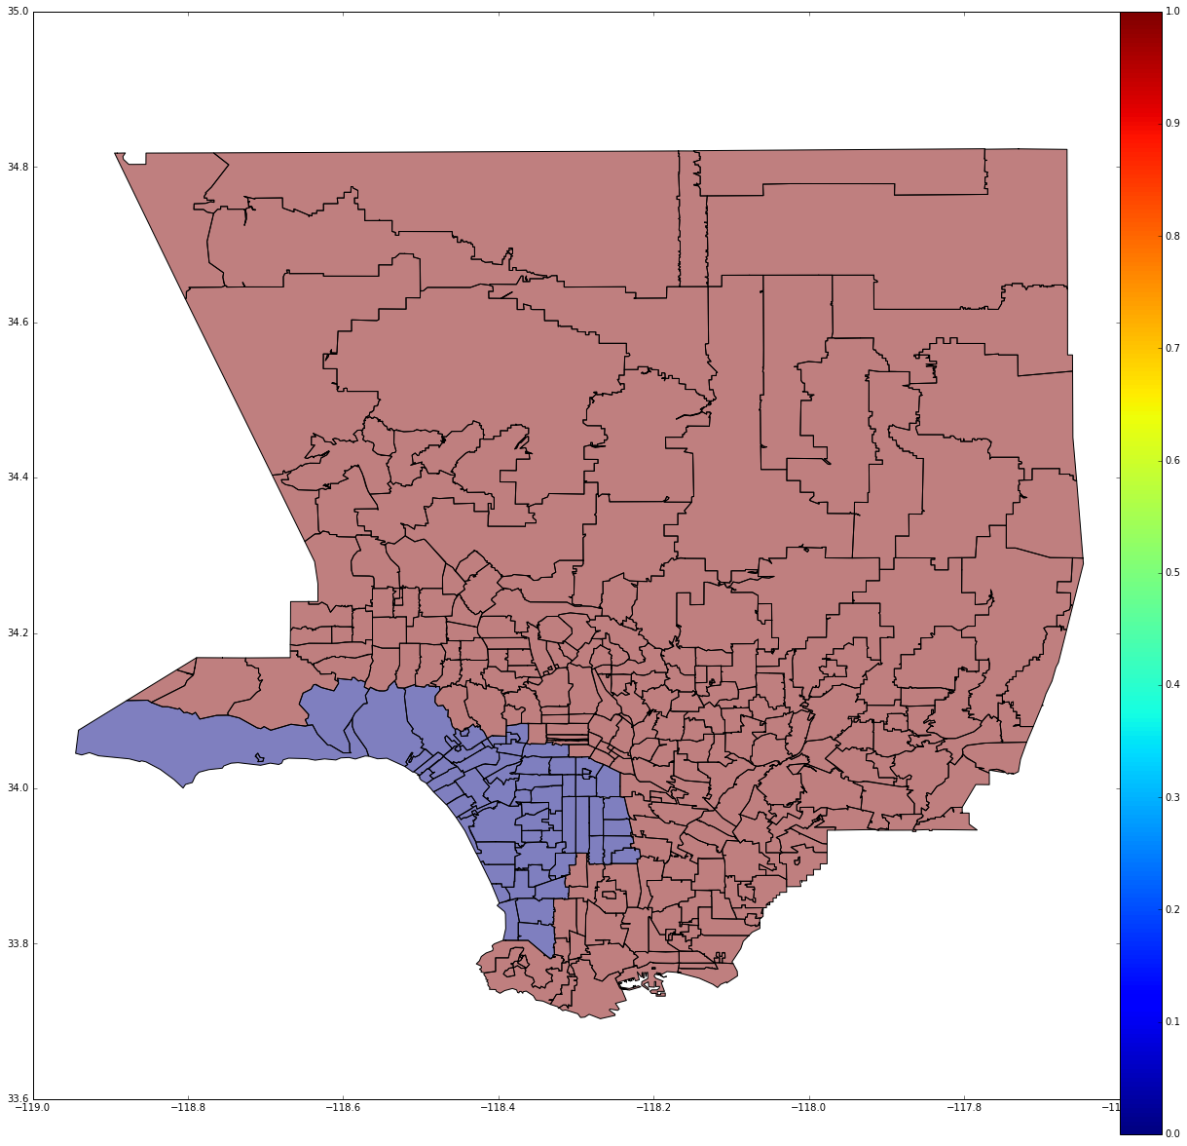
Travel Time
Time Difference
Best option : LAX
Notes:
Jules

Slide 46
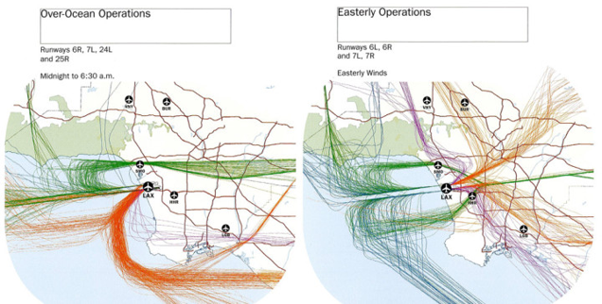
Future Analysis
Particular emphasis will be placed on determining both cost of rescheduling and potential for fuel savings and carbon footprint reduction due to delay reductions.
We will begin to check the robustness of the scheduler to see if such a method is feasible under conditions of uncertainty.
Further refinement of the model to reflect real airspace conditions and Improvement of computation time efficiency
Notes:
John

Slide 47
Impacts of New Schedule
A theoretical passenger lives somewhere between LAX and BUR, and flies to BUR instead of LAX (assuming Boeing 737-800)
Time
Like most LA travelers, the passenger travels by car
Net ground travel time change: +/- 40 minutes
Reduced air delay: 3.1 min air (5.4 min block)
Net change for passenger 45.4 minutes less to 36.9 minutes more.
Money
The airline saves $2.30 on operating cost/passenger on block delay
The passenger spends +/- $2.94 on fuel
LAX landing fee and terminal concession revenue goes to BUR
Emissions
The airline reduces its carbon footprint by 1.65 lbs CO2/passenger
The passenger’s carbon footprint changes by +/- 19.7 lbs CO2
X passengers end up closer to their destination
Y passengers end up farther from their destination
The Big Question: How many passengers on that flight will end up closer to vs. farther from their destination?

Slide 48
Implementation
Air travel to/from LA Area would be similar to pre-deregulation
Government or other governing body regulates frequency of flights, departure times, and destination airports
Many entities involved:
Nearly all domestic airlines and some international airlines
LA Area airports, and all airports with non-stop service to this region
The FAA and Air Traffic Controllers
Federal, state and local governments
Local communities
International communities
Notes:
Jerry

Slide 49
Incentives
The current free market minimizes costs to all entities
Any disruptions will come at costs to at least some users:
Costs of increased ground/road travel time and pollution
Costs of more complex international connections
Costs of reduced airline and airport revenue
Psychological costs associated with loss of convenience
Existing incentives:
More efficient airside travel experience
Reduced aircraft operating costs and pollution
Some individuals may not accept any incentives at all
Notes:
Jerry

Slide 50
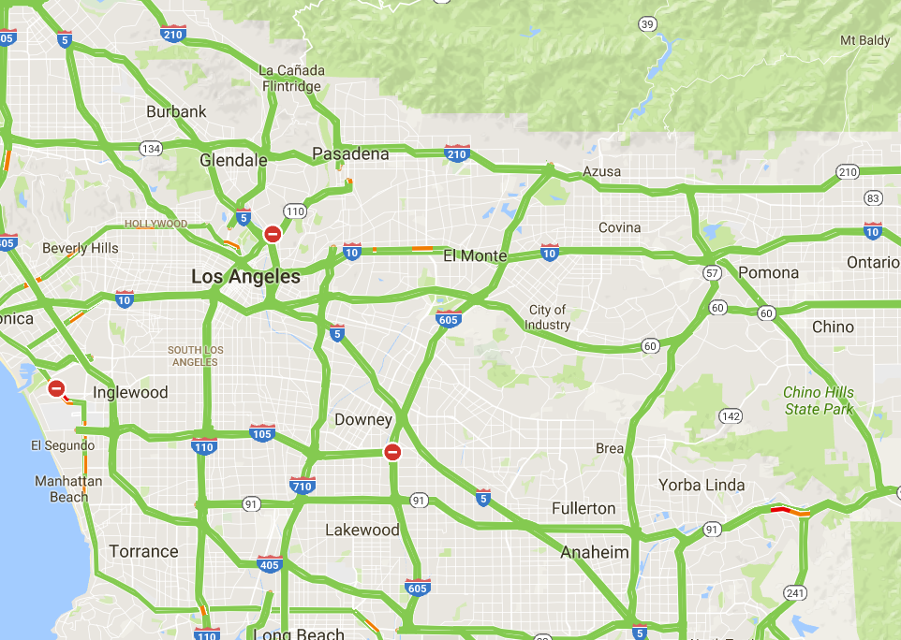
Pros
Reduced emissions
Better passenger experience
Possible cost savings
A better utilized system
Reduced ground traffic
Possible increased profits for airlines
Time savings!
… but for the air and airport taxiways
Notes:
Jack

Slide 51
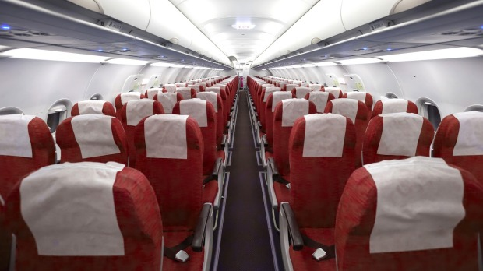
Cons
Changing from the norm
Rerouting flight paths
Passengers could be resistant to change
Increased traffic at 4 airports other than LAX
Loss of profit for LAX
Might not be a demand for rerouted flights
Notes:
Jack

Slide 52
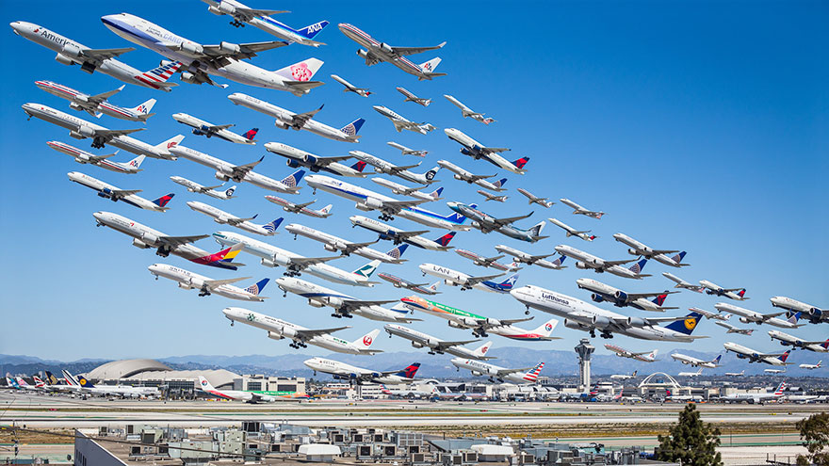
Summary
Background research on the LA airport markets
Obtained data from ASPM and Google Maps
Visualized both data sets
Optimized and analyzed data
Outline implementation of our proposed solution
Notes:
Everyone

